Slide 1
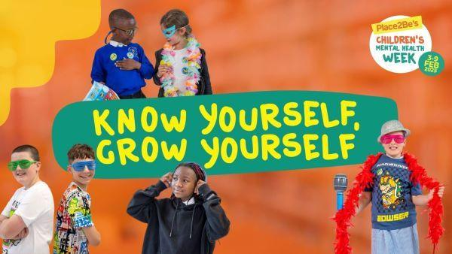

Slide 2
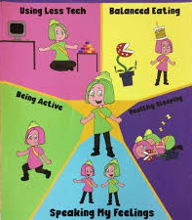
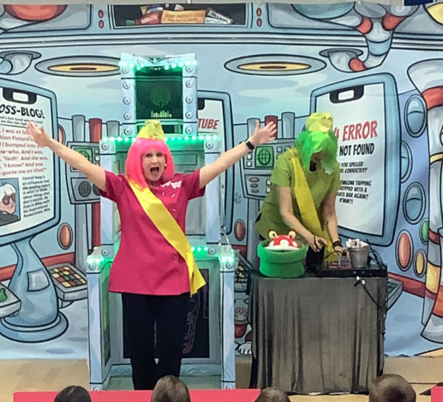

Slide 3


Slide 4
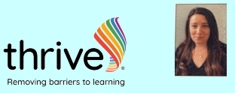

What is Thrive? How can Thrive help you?
Mental Health
Emotional well-being
Social development
Thrive helps teachers make sure you feel happy, safe, and ready to learn by giving you fun activities and tools to help with feelings and making friends.

Slide 5
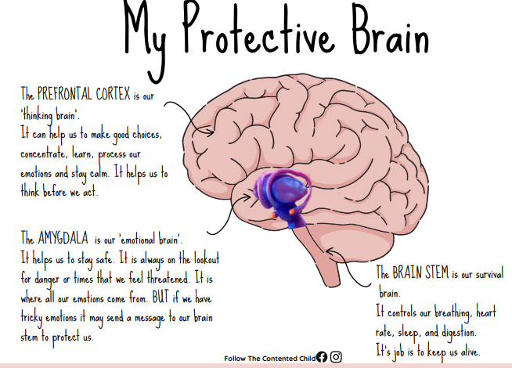
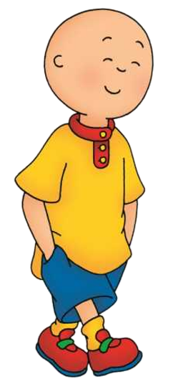
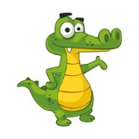
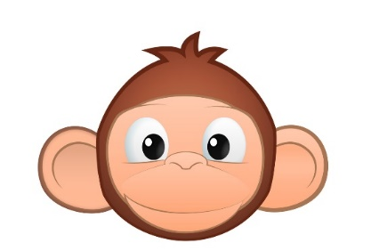
CORTEX - This is our thinking brain.
It helps us make good choices, concentrate, learn, process our emotions and stay calm. It helps us to think before we act.
Also called our child brain.
LIMBIC SYSTEM - This is our emotional brain. It helps us to stay safe. It helps us understand and manage our feelings.
It is where all our emotions come from.
Also called our chimp brain.
BRAIN STEM - This is our survival brain. It controls our body to keep us breathing, sleeping, eating. Its job is to keep us alive.
Also called our alligator brain.

Slide 6
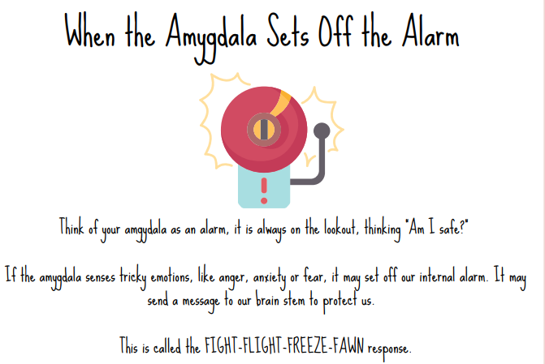

When the alligator sets off the alarm
Think of your alligator brain as an alarm. It is always on the lookout, thinking ‘Am I safe?’
If the alligator senses tricky emotions, like anger, anxiety or fear, it may set off our internal alarm
It may send a message to protect us.
https://www.youtube.com/watch?v=Kx7PCzg0CGE

Slide 7
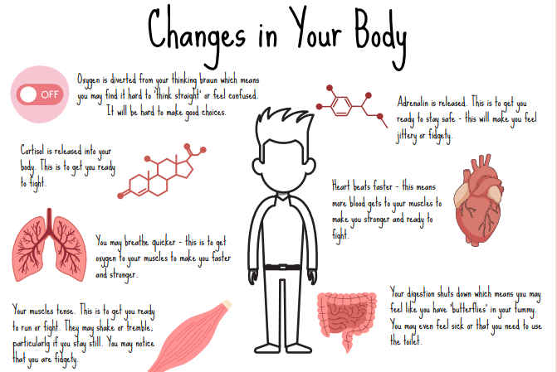
Our brains may switch off and it is hard to think and make good choices.
Adrenaline is released. This is to get you ready to stay safe –this will make you feel jittery or fidgety.
Your heart might start beating faster, you feel hot and sweaty.
Your tummy shuts down which means you may feel like you have ‘butterflies’ in your tummy. You may even feel sick or need the toilet.
Your muscles tense. They may shake or tremble.

Slide 8
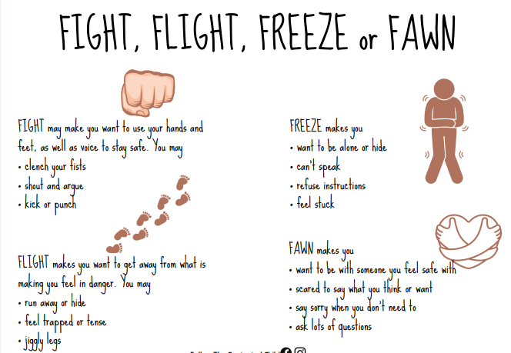


Slide 9
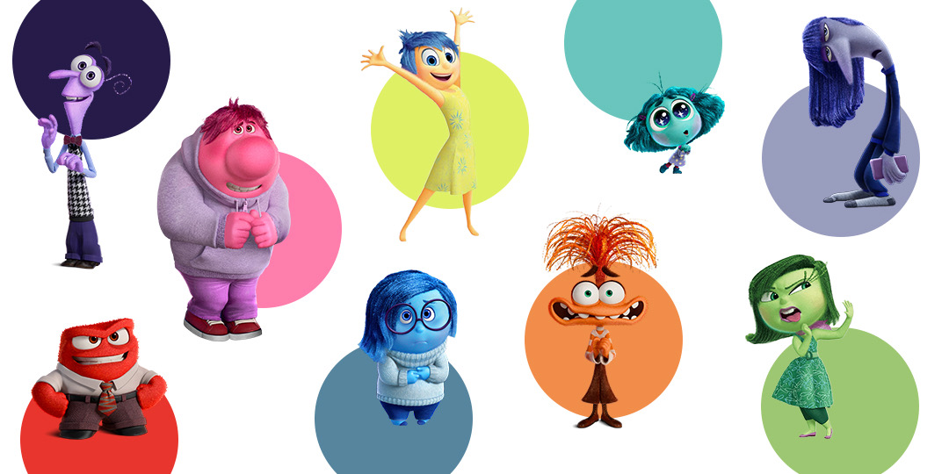

What can we do in school to help us feel calmer and get all of our brain back up and running as a team?

