Slide 1
Teach reading: change lives
Parent workshop: Phonics and early reading

Slide 2
A love of reading is the biggest indicator of future academic success.
OECD (The Organisation for Economic Co-operation and Development)

Slide 3


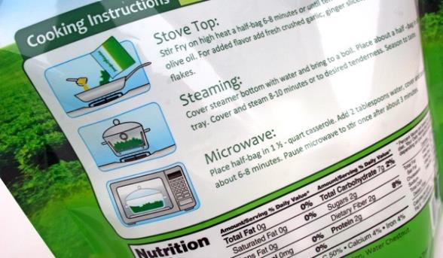
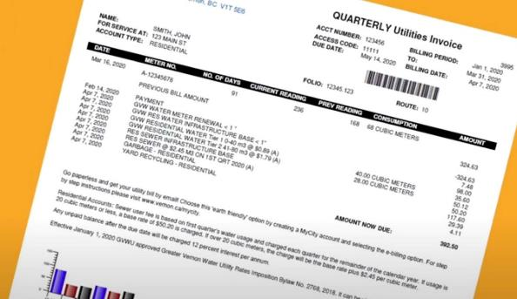
How many times have you already read today?
Notes:
Just think about how many times you have already read things today. It really is a vital skill.
I’m sure I don’t need to tell you
My children fed up with me saying how important it is!! They all know they are learning to read!!!

Slide 4

Phonics

Slide 5

Little Wandle Letters and Sounds Revised
Our school has chosen
Little Wandle Letters and Sounds Revised as our systematic, synthetic phonics (SSP) programme to teach early reading and spelling.
Notes:
The DFE decided that current phonics programs weren’t fit for purpose
We researched LOTS of schemes and had the luxury of taking our time due to Ofsted grading.
We finally settled on LW and I feel it was a good choice as it is based on letters and sounds which we used before. All schools in our trust are using it so we have good support and the English teams regularly meet
We started in September and there has been a lot of aspects to get our head round and resources!!

Slide 6
Phonics is:
making connections between the sounds of our spoken words and the letters that are used to write them down.
Notes:
So phonics is…
It sounds complicated but it really isn’t!

Slide 7

Blending to read words
Notes:
Some children learn to blend really quickly, and others take a little longer.
Show parents this video from the website: https://www.littlewandlelettersandsounds.org.uk/resources/for-parents/

Slide 8
Terminology
Phoneme
Split vowel digraph
Grapheme
Blend
Digraph
Segment
Trigraph
Notes:
You may hear your chn say this lovely jargon
Phoneme- The smallest unit of sound that can be identified in words. We sometimes simply call this a ‘sound’
Grapheme- A letter or group of letters used to represent a particular phoneme when writing. SO how we write the sound down
Digraph- 2 letters that make one sound like sh ch
Trigraph- 3 letters that make 1 sound igh air ear
Split digraph – a-e A digraph representing a vowel sound where its two letters are split by an intervening consonant (for example, ‘a_e’ in ‘take’). Despite having a consonant in between them, the two letters involved (here ‘a’ and ‘e’) still count as one digraph, making one sound.
Blend- putting the sounds together in a word in order to read f-r-o-g-frog
Segment- how we break down the words to spell frog f-r-o-g

Slide 9
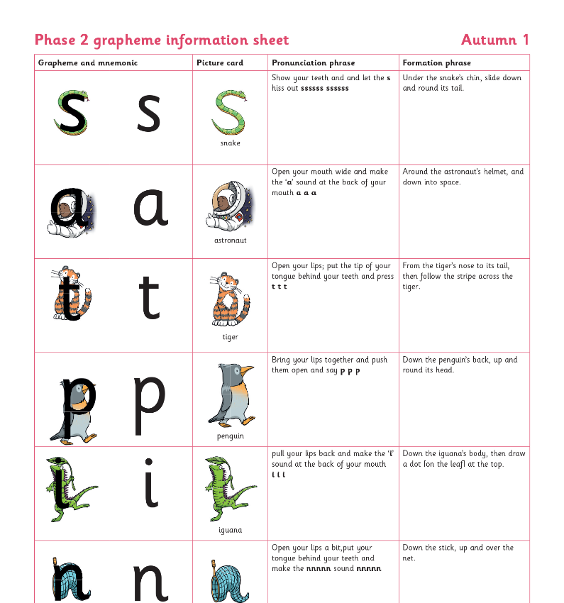
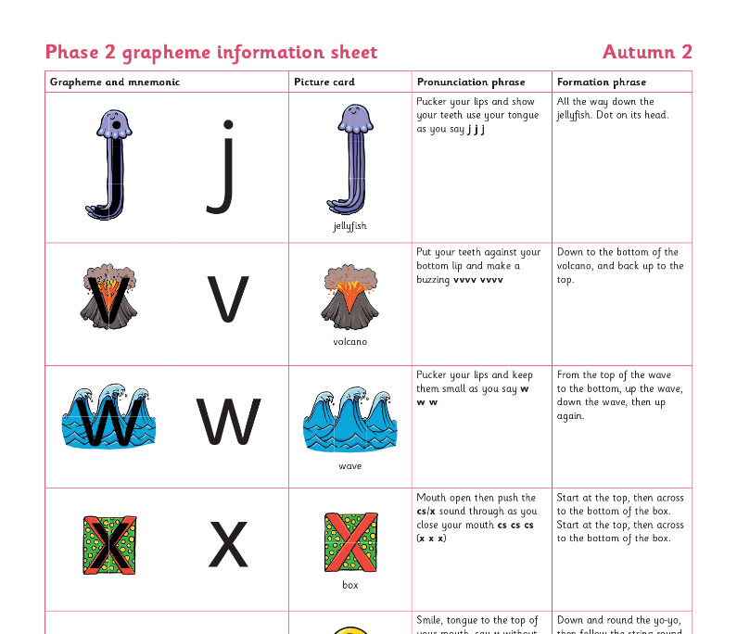
Teaching order
Notes:
We usually teach four new sounds a week and have a review lesson on a Friday.

Slide 10
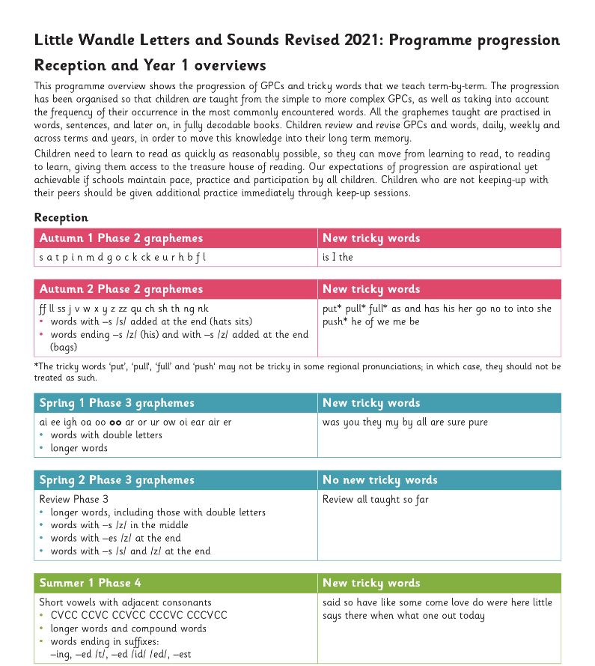
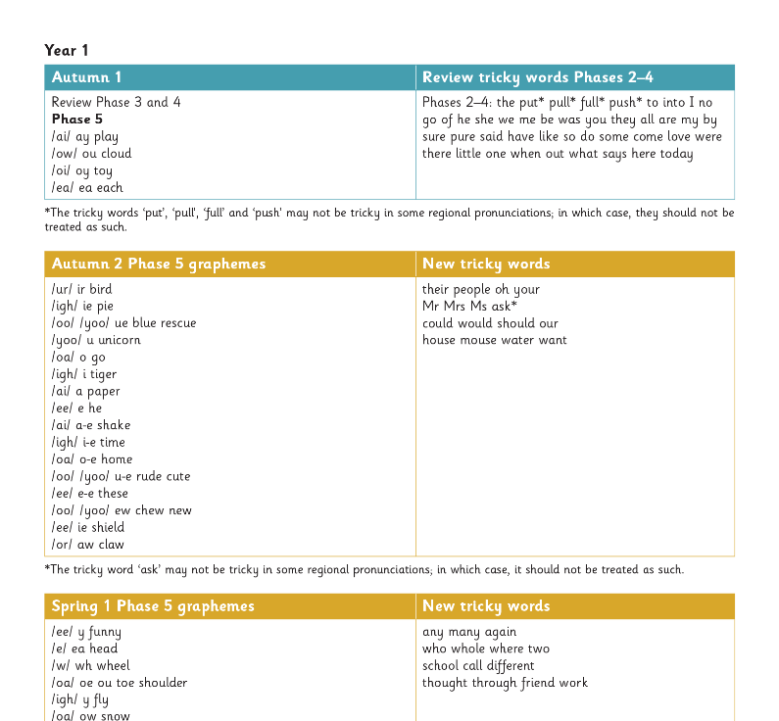
Gradually your child learns the entire alphabetic code:
Notes:
We will work our way through the whole Little Wandle Programme until your child can read fluently.

Slide 11


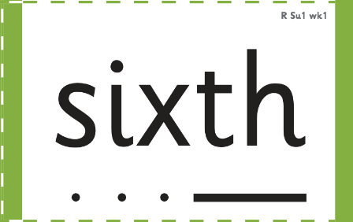

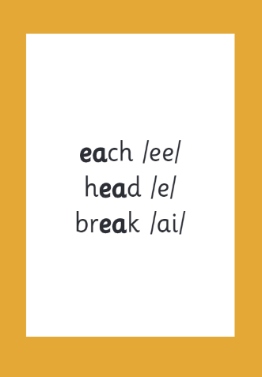

How we make learning stick
Notes:
There are specific resources for the Little Wandle Programme which the children will be very familiar with. Each sound that we teach to begin with has either a mnemonic (like the astronaut that you can see here) or a phrase like boing-boing for ‘oi’. This helps the children recognise and remember the graphemes. Every time we teach a new sound, we also read words during the phonics lesson that contain that new sound so that the children practise what they have learned. We then go on to reading a sentence containing some of those words. We have displays in the classroom to support the children throughout the day.
Just to note that our year 1 chn wont know all of the menemoniocs- some of them. Due to not doing this program in reception. They are doing so well though and have really taken to it this year

Slide 12
Reading and spelling

Slide 13


Reading and spelling
Notes:
This is an example of what the children learn in Year 1.
Children learn that there are graphemes that can have different sounds and sounds that can be made with different letters.
Use the backs and fronts of Phase 5 cards to show ‘ea’ and ‘ow’.
Chn are so good when we show the cards saying all the different sounds that sometimes I have to look and think hard!!!
They are good at knowing the grow the code chart which shows all the different sounds graphemes they are learning

Slide 14
And all the different ways to write the phoneme sh:
shell
chef
special
caption
mansion
passion
Notes:
Poor things!!! This is yet to come!! They know the first 2

Slide 15
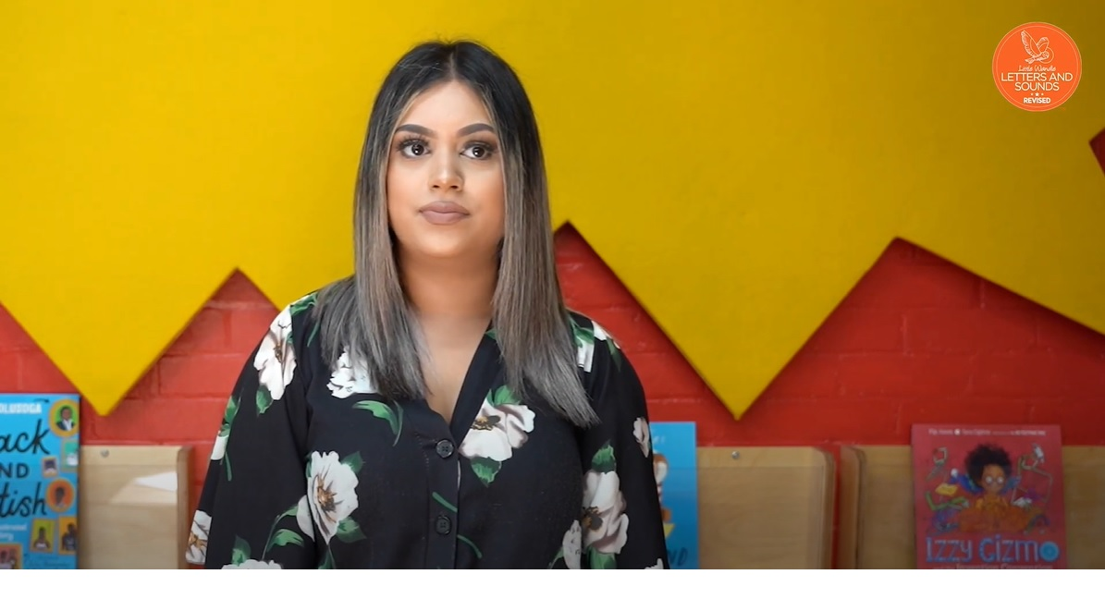
Tricky words
Notes:
Have a look at this video on the website: https://www.littlewandlelettersandsounds.org.uk/resources/for-parents/
Chn are very good at spotting how its not a tricky word anymore when they have learnt the alternative sounds e.g. to our chn now we she he can be decoded as they know e and the word like because they know split i-e

Slide 16

Spelling
Say the word.
Segment the sounds.
Count the sounds.
Write them down.
Notes:
Model the process on a flipchart for the parents to see.
P-l-ay
Say it – chn repeat Hand on ear
Count sounds
Model writing
Then hide
Chn write then we check it looks like mine
Encourage segmenting chn know the word segment

Slide 17
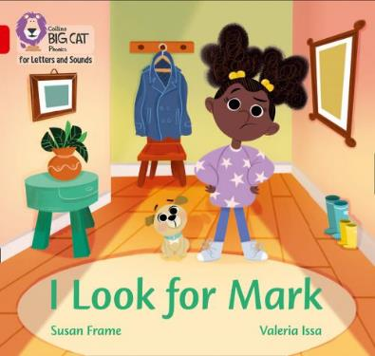
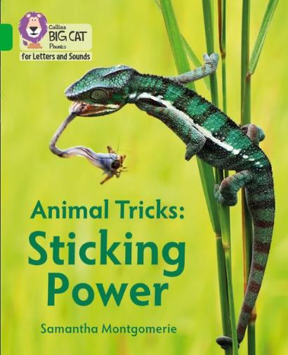
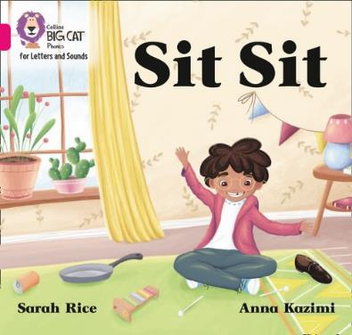
How do we teach reading in books?
Reading practice sessions are:
daily
taught by a trained teacher/teaching assistant
taught in small groups.
Notes:
The children read the correct level book for them and their group. This tends to be a book band higher but not always if the chn are struggling They have 2 reads with an adult each week. They may also repeat the book for a third read independently if appropriate The first time we work on decoding (sounding out) the words, the second time we work on prosody which is reading with expression – making the book sound more interesting with our story-teller voice or our David Attenborough voice – and we also look at comprehension. We also want to develop the fluency. The more they see words the more they begin to read them automatically without having to sound them out.

Slide 18
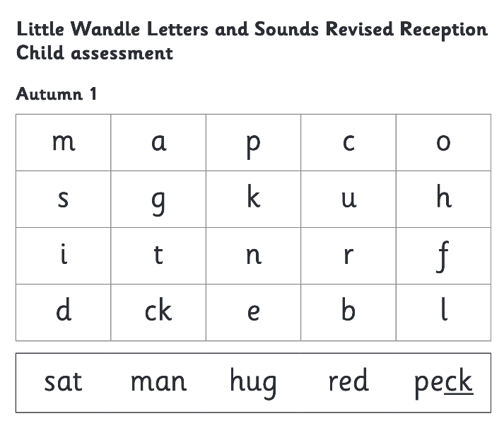
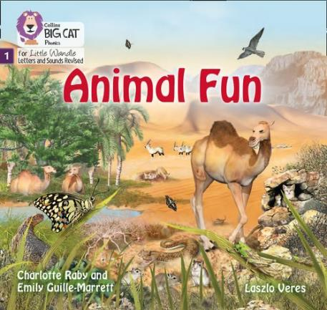
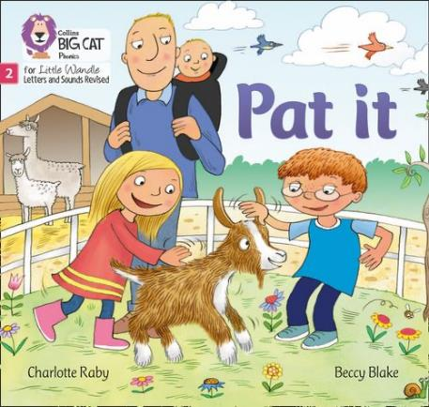
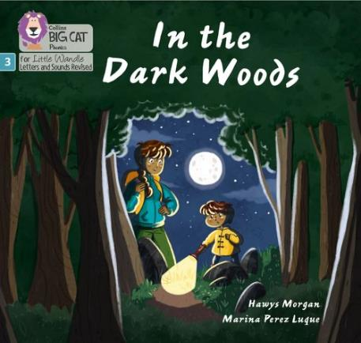
We use assessment to match your child the right level of book
Notes:
We assess your child every six weeks to check progress. Children who need extra support have keep-up sessions planned for them.

Slide 19
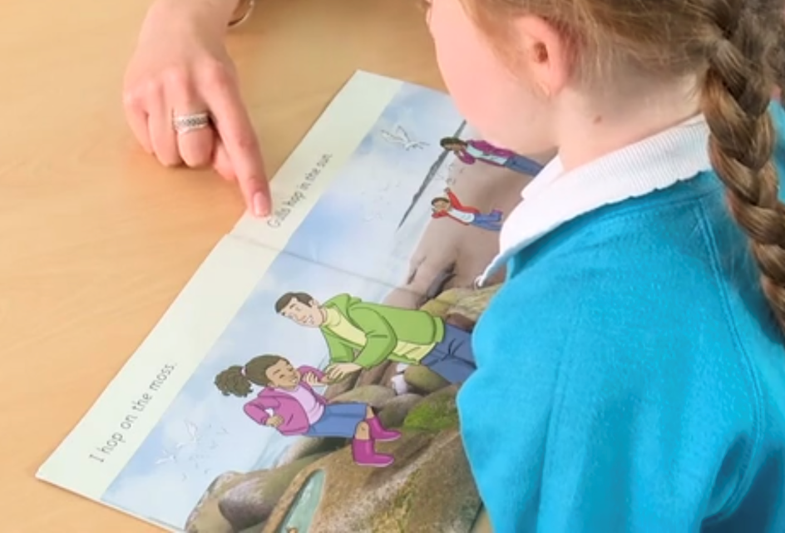
Reading a book at the right level
This means that your child should:
Know all the sounds and tricky words in their phonics book well
Read many of the words by silent blending (in their head) – their reading will be automatic
Only need to stop and sound out about 5% of the words.
Notes:
The books home should be an easy read

Slide 20
Reading at home

Slide 21
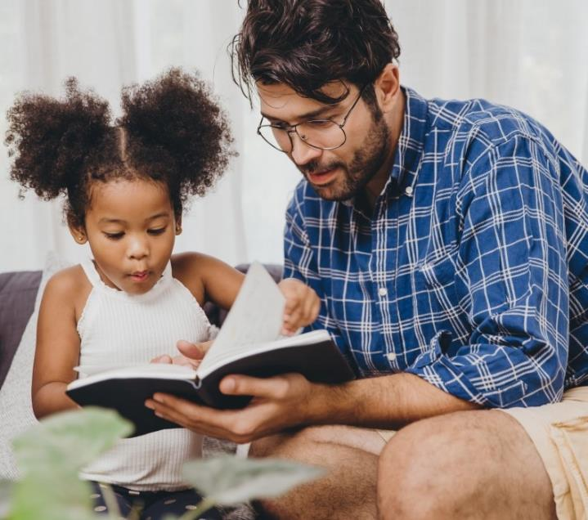
The most important thing you can do is read with your child
Reading a book and chatting had a positive impact a year later on children’s ability to…
understand words and sentences
use a wide range of vocabulary
develop listening comprehension skills.
The amount of books children were exposed to by age 6 was a positive predictor of their reading ability two years later.
Parental involvement in the development of children’s reading skills: A five-year longitudinal study (2002) Senechal, M. and Lefvre, J
Notes:
Celebrate child’s success at school, make time for reading at home!

Slide 22

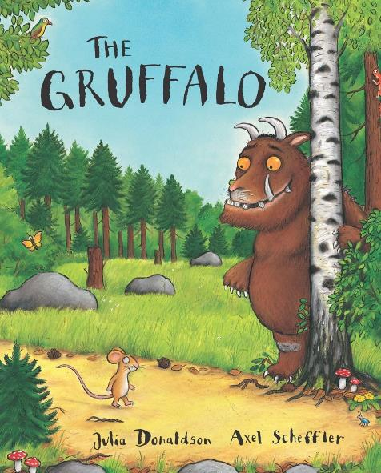
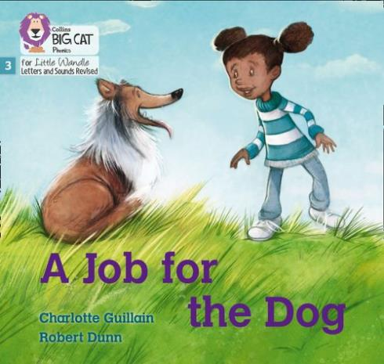
Books going home
Notes:
As well as the ‘learning to read’ book that your child will bring home they will also bring home a book for sharing with you. This book is from the library sessions we have each week. This is how we are going to give them the WILL to read. Please read with your child as often as you can. That’s why we introduced the reading bugs to encourage chn to read at least 3 times a week to you

Slide 23
Listening to your child read their phonics book
Your child should be able to read their book without your help.
If they can’t read a word read it to them.
Talk about the book and celebrate their success.

Slide 24
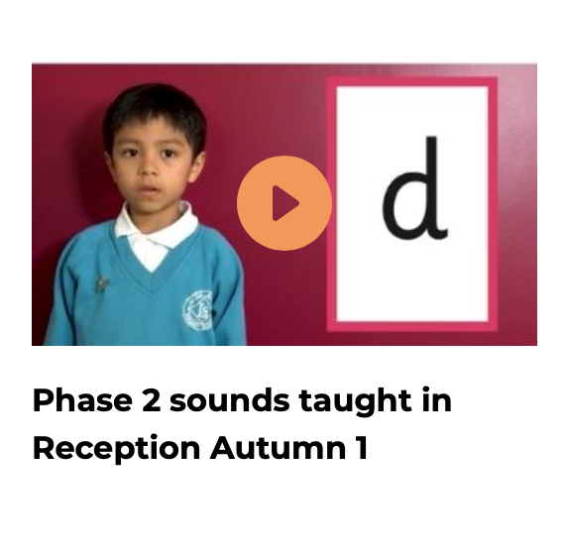
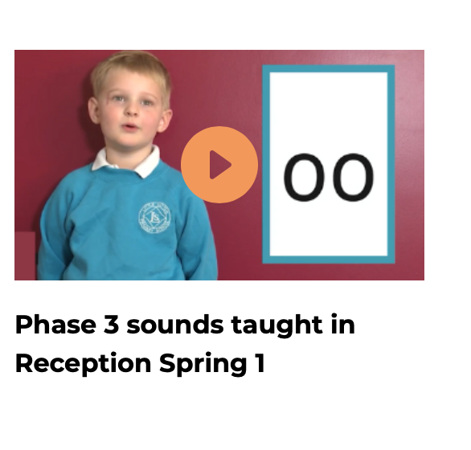
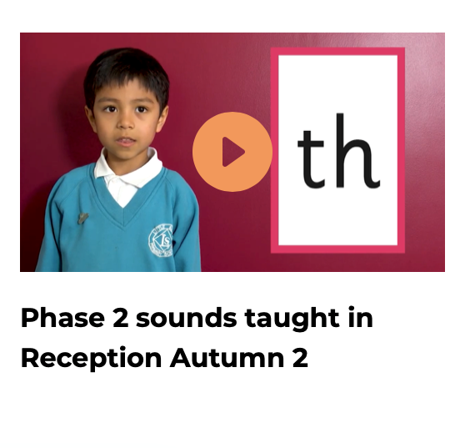
Supporting your child with phonics
Notes:
It is really important that you pronounce the sounds correctly at home if you are supporting your child. These videos are on the website for you to refer to and if you are unsure, please ask your child’s teacher.
2These videos are on our website.
play them!
https://www.littlewandlelettersandsounds.org.uk/resources/for-parents/

Slide 25

Read to your child
The shared book is a ‘reading for pleasure book’ from the school library:
To become lifelong readers it is essential that they read for pleasure
Children may not be able to read this book independently but they offer a wealth of opportunities
They may be non-fiction with information to read and learn.
You may enjoy story books together – discussing and sharing plot ideas and predictions.
Notes:
Or read from home as mamny as you like!!

Slide 26
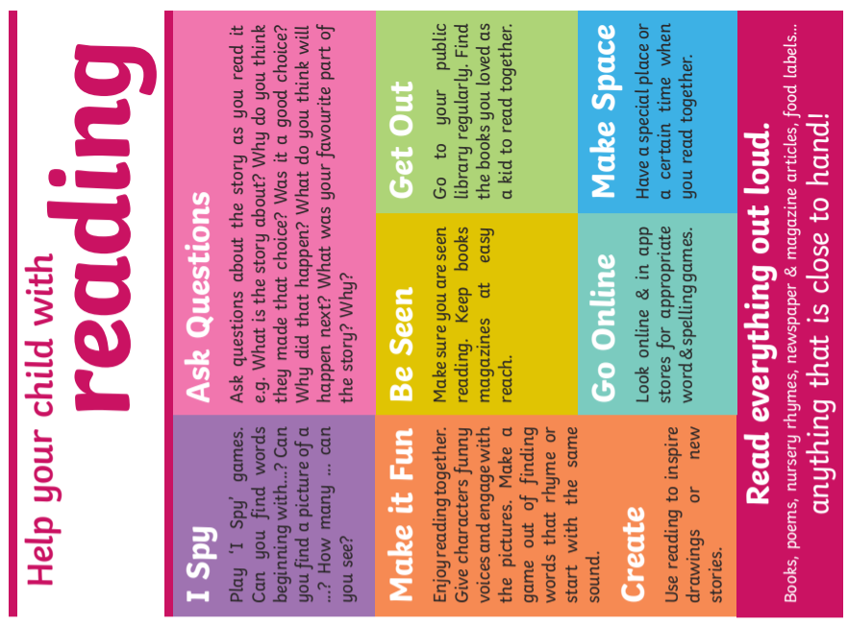
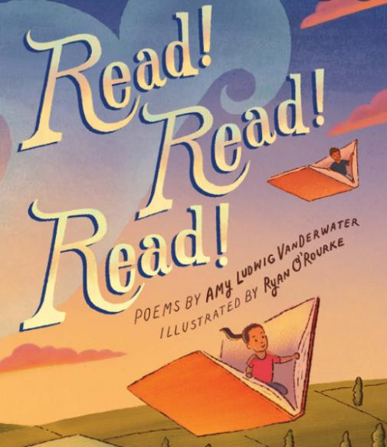

Slide 27
One of the greatest gifts adults can give is to read to children
Carl Sagan

